Slide 1
Frames: A 3-D Image Recording and Display System
Group 7
Christian Vartanian [EE] Daniel Hureira [CpE] Jamesley Rock [CpE]

Slide 2
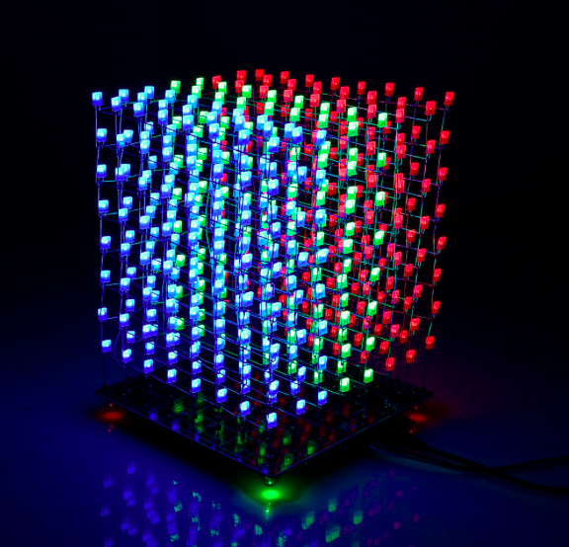
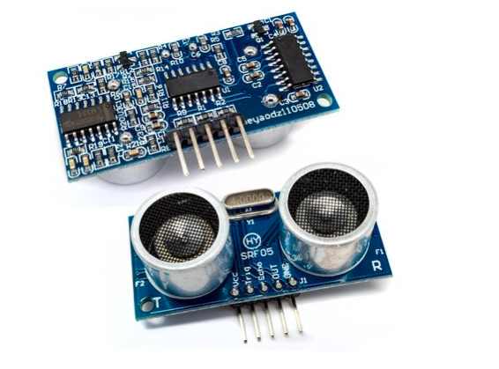
Project Description
Our project consists of two main parts
- LED Cube
- Ultrasonic Sensor Array

Slide 3
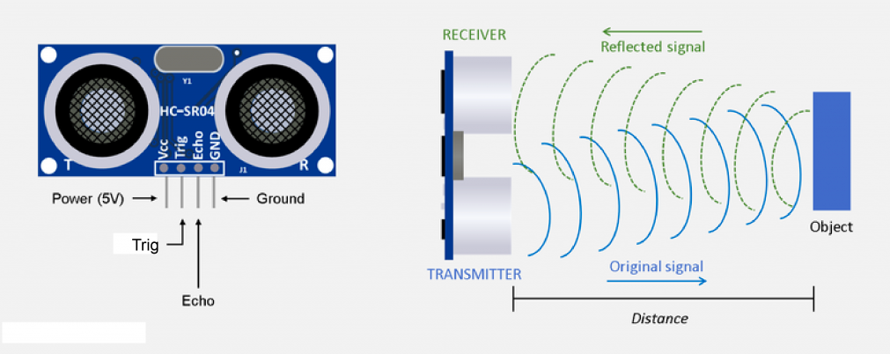
Project Description
Ultrasonic Sensor acts as the input
Input is scanned, then processed, then displayed.

Slide 4
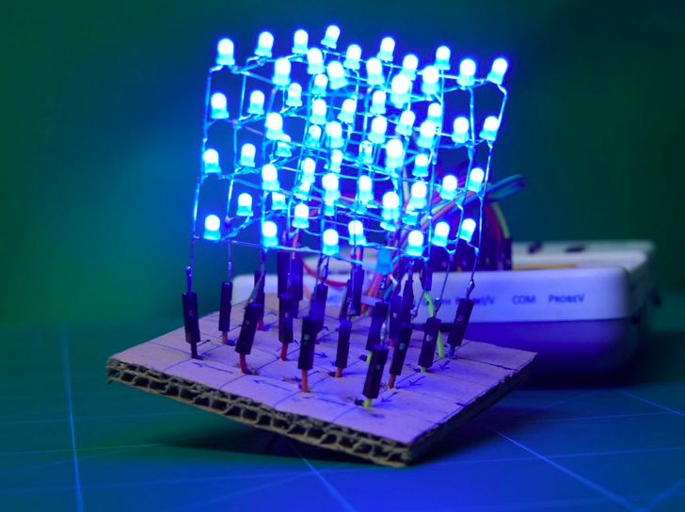
Project Description
LED Cube acts as the output
Cube output indicates distance
Sound component also used to indicate distance

Slide 5
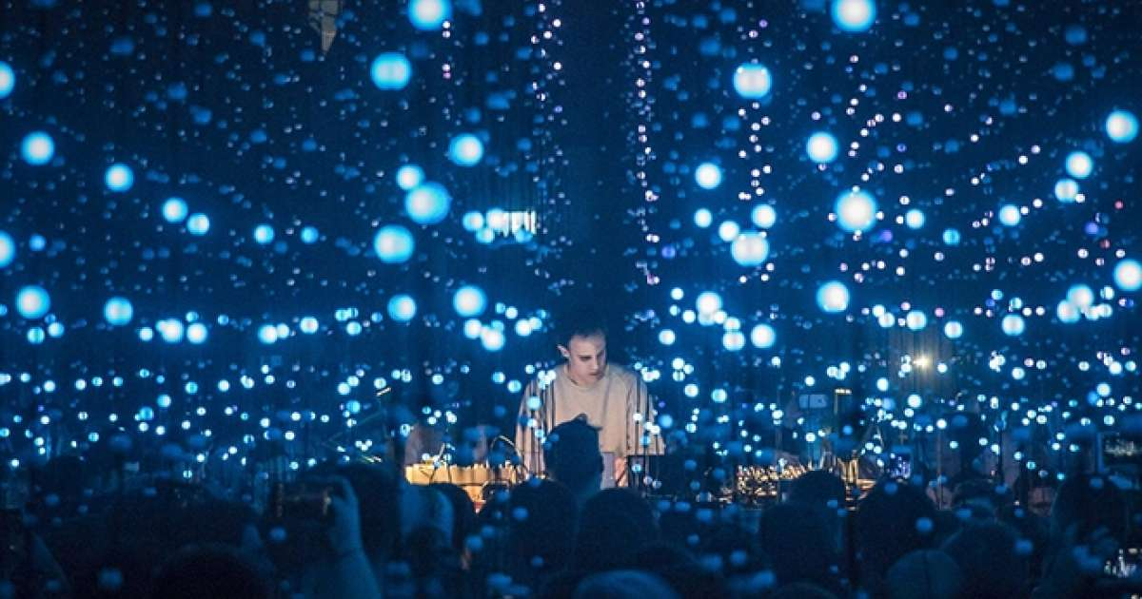
Inspiration
Inspiration came from two main sources.
Light shows

Slide 6
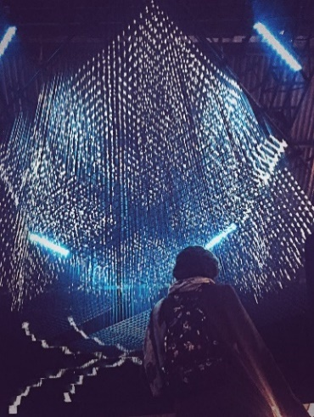
Inspiration
Inspiration came from two main sources.
Max Cooper’s light installation

Slide 7
Project Goals
To utilize the skills learned over the years while acquiring our degree to build a fun/interesting project.
Project uses
Music Festivals
Concerts
Personal Entertainment
Movement Sensor

Slide 8
Design Approach
After choosing our design, our approach was to section the main points needed to complete our design and do research to find the best way to complete the design.

Slide 9
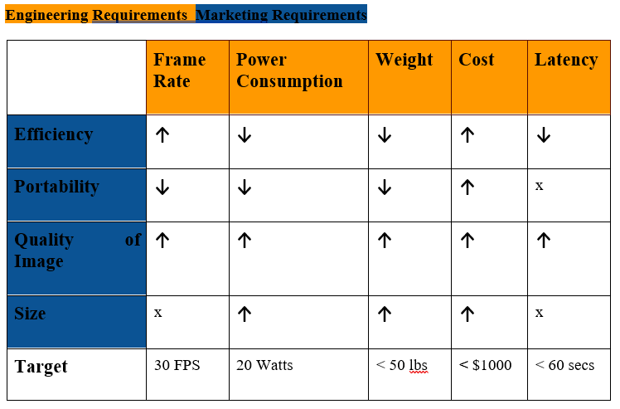
Requirements & Specifications
↓ = Negative Correlation (i.e. as power consumption is increased, efficiency is decreased)
↑ = Positive Correlation (i.e. as the quality of image increases the cost also increases)
x = No Direct Correlation

Slide 10
Requirements & Specifications (cont.)
Targets met:
Weight
Cost
Latency
Power Consumption

Slide 11
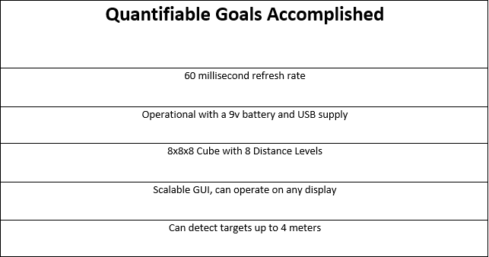
Requirements & Specifications (cont.)
To the left are the quantifiable goals we accomplished for this project

Slide 12
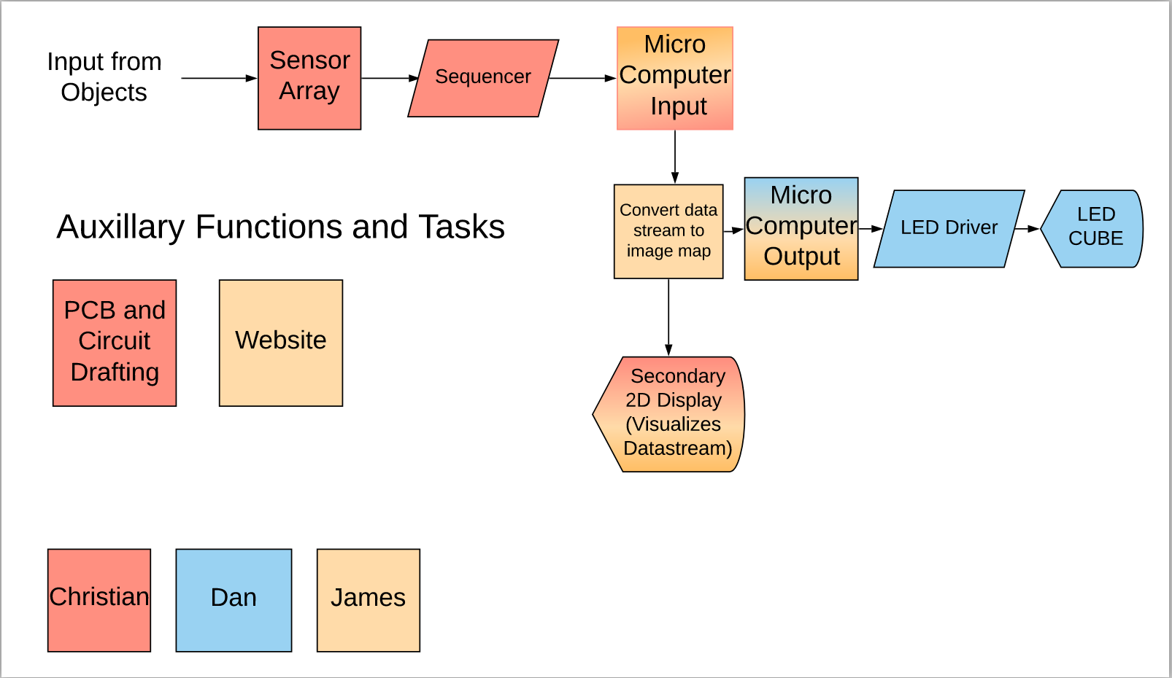
Project Diagram/Work Distribution

Slide 13
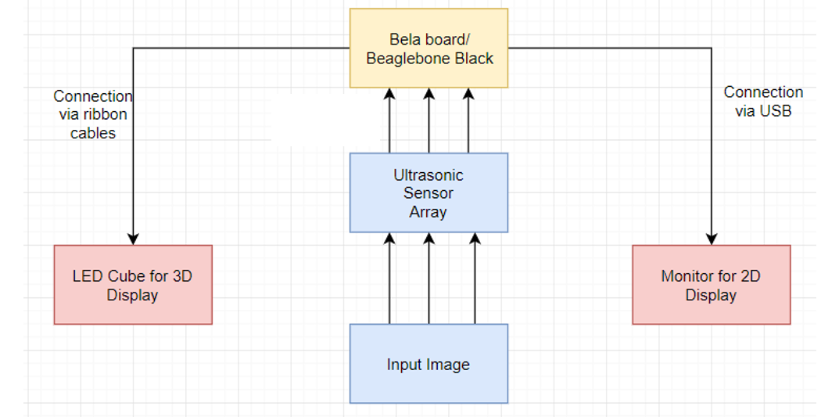
Proposed Implementation

Slide 14
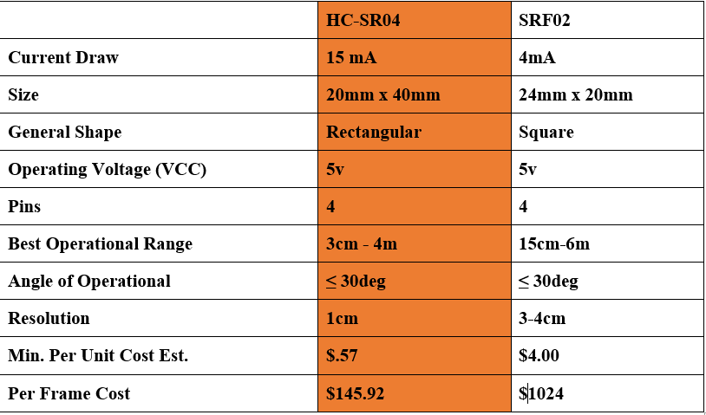
Hardware Considerations
Chart to the left compares two sensors: The HC-SR04 and the SRF02.
We ended up using the HC-SR04

Slide 15
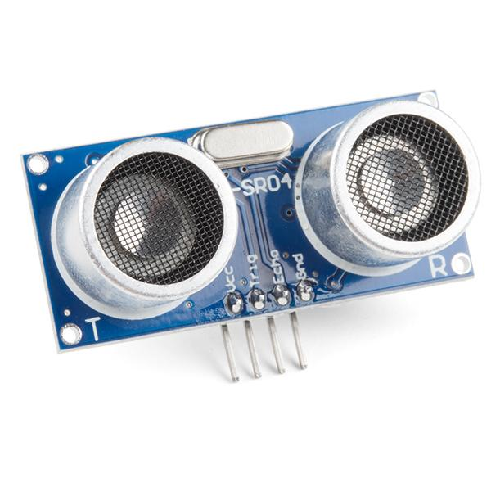
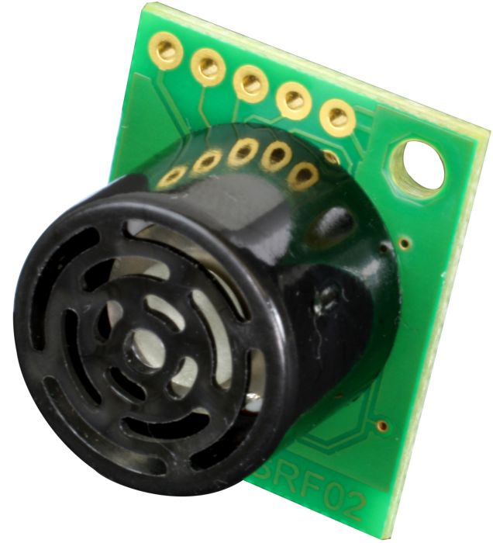
Hardware Considerations (cont.)
SRFO2 Sensor
HC-SR04 Sensor

Slide 16
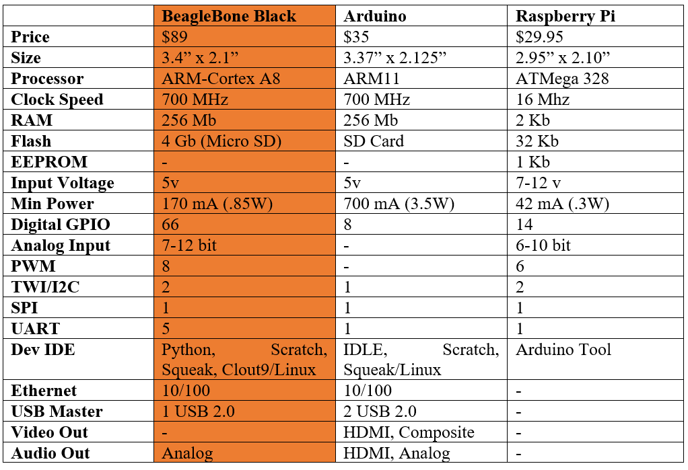
Hardware Considerations (cont.)
Chart to the left compares the Arduino, Raspberry Pi and Beaglebone Black
We are using the Beaglebone Black.

Slide 17
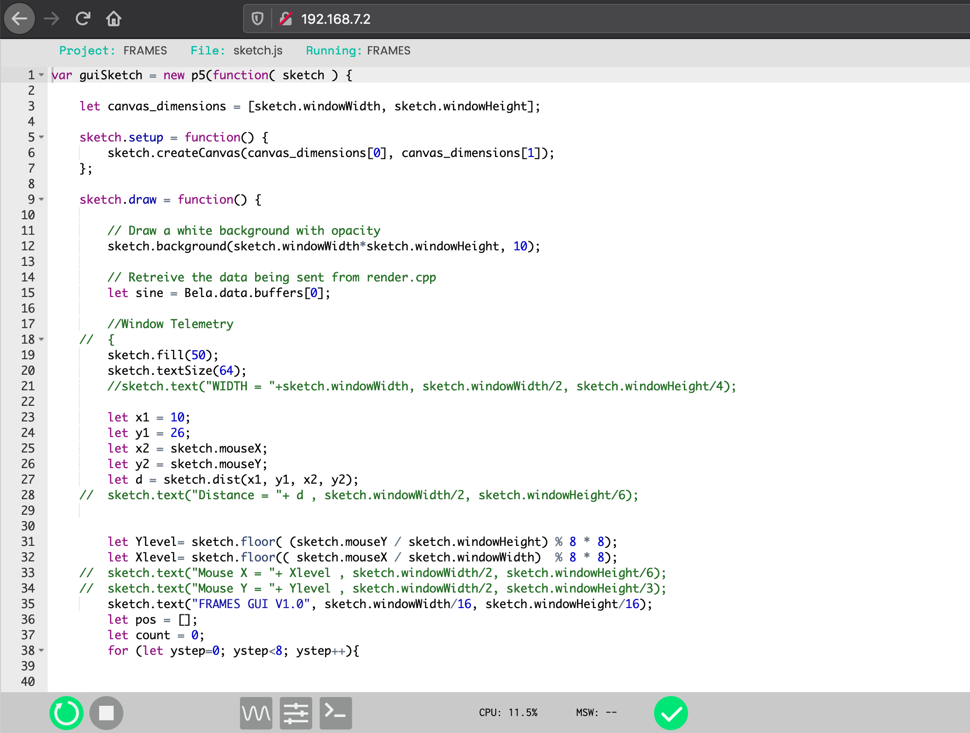
Software Integration
The Bela/Beaglebone uses C++ for on board analog processing and Javascript for graphics management
2D implementation of this project via the software component
Custom browser based IDE for rapid development and deployment allows for a swift programming process that can be taken anywhere.

Slide 18
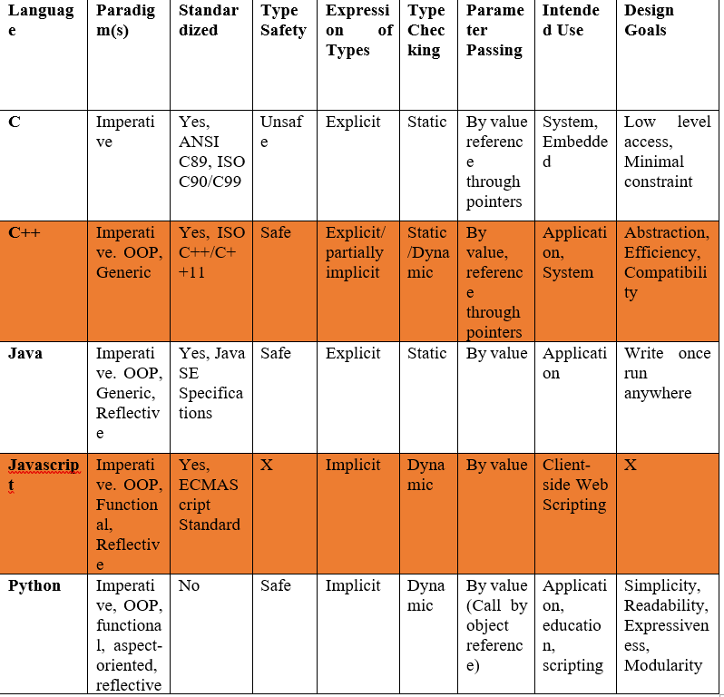
Software Comparison
Chart to the left compares languages that can be used.
For the software component our team decided to use C++ and Javascript

Slide 19
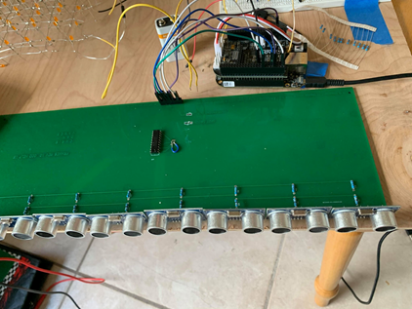
Ultrasonic Sensor Design
•PCB used to hold all our sensors in place
•Also added OR gates for multiplexing each ultrasonic sensor

Slide 20
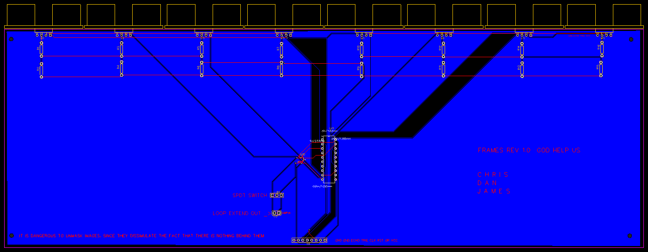
Ultrasonic Sensor Design PCB Layout

Slide 21
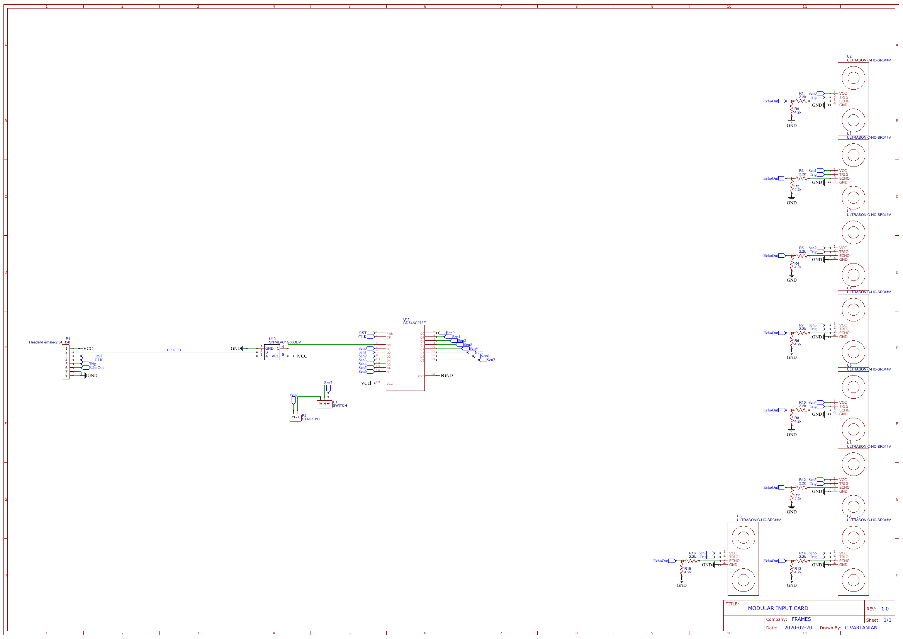
Ultrasonic Sensor Design (cont.)

Slide 22
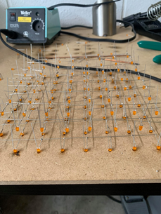
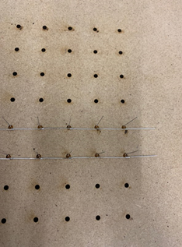
LED Cube Construction
A “frame” is needed in order to properly build the cube
To accomplish this, we took a piece of wood, cut out holes measuring the width of the LED, then spaced each hole by the measurement of the cathode leg
The LEDs are then placed in each hole with the cathode bent 90 degrees to reach the next hole/cathode. Then it is soldered together.

Slide 23
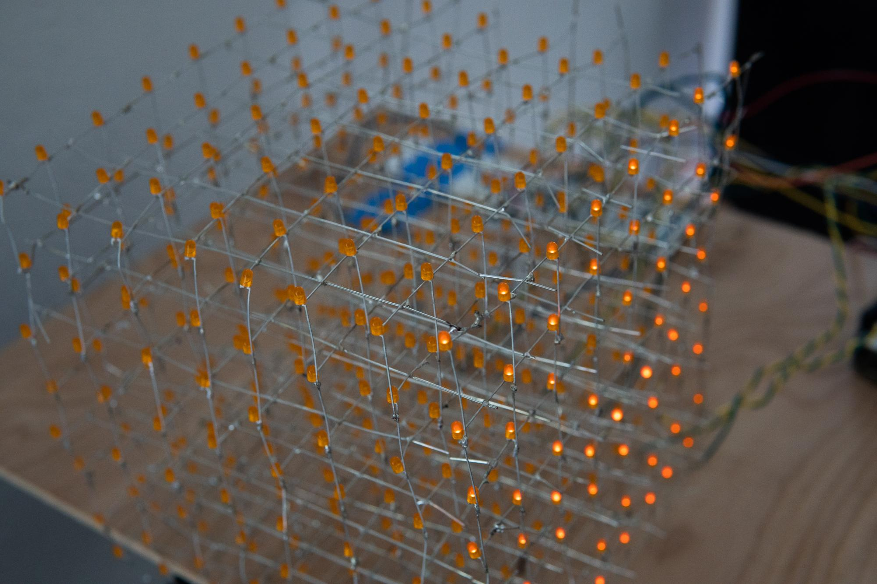
LED Cube
LED Cube a main component of our project
Originally, we wanted to make it 16x16x16. Decided to scale back to 8x8x8.

Slide 24
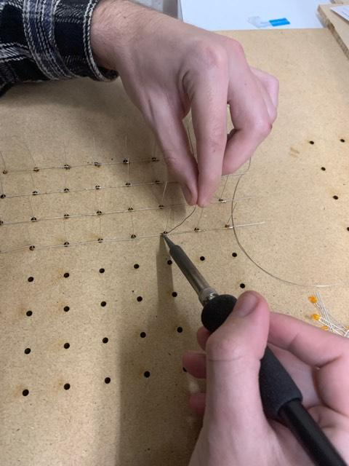
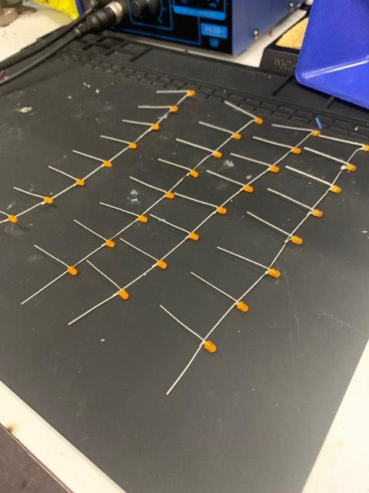
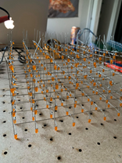
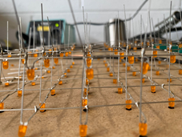
LED Cube Construction (cont.)
Soldering the anodes to make the columns of the Cube
Soldering the cathodes to make the layers.

Slide 25
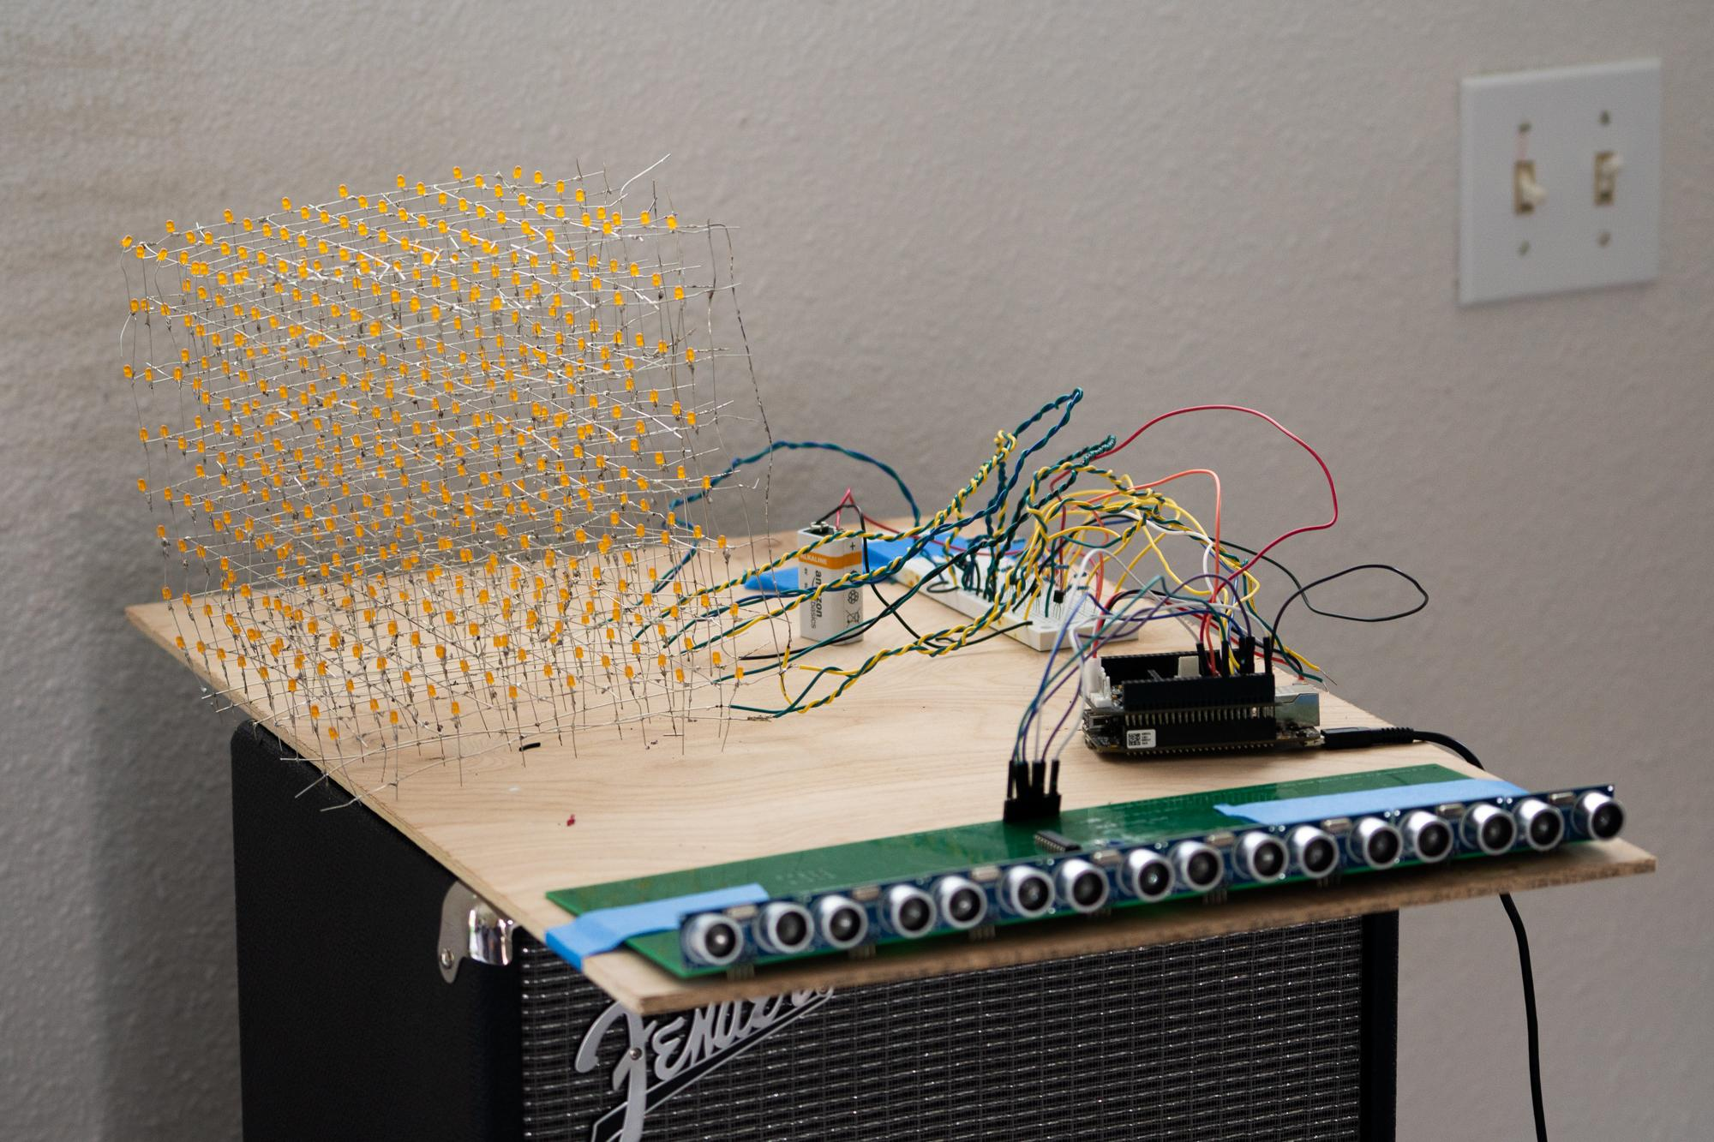
LED Cube Construction (cont.)

Slide 26
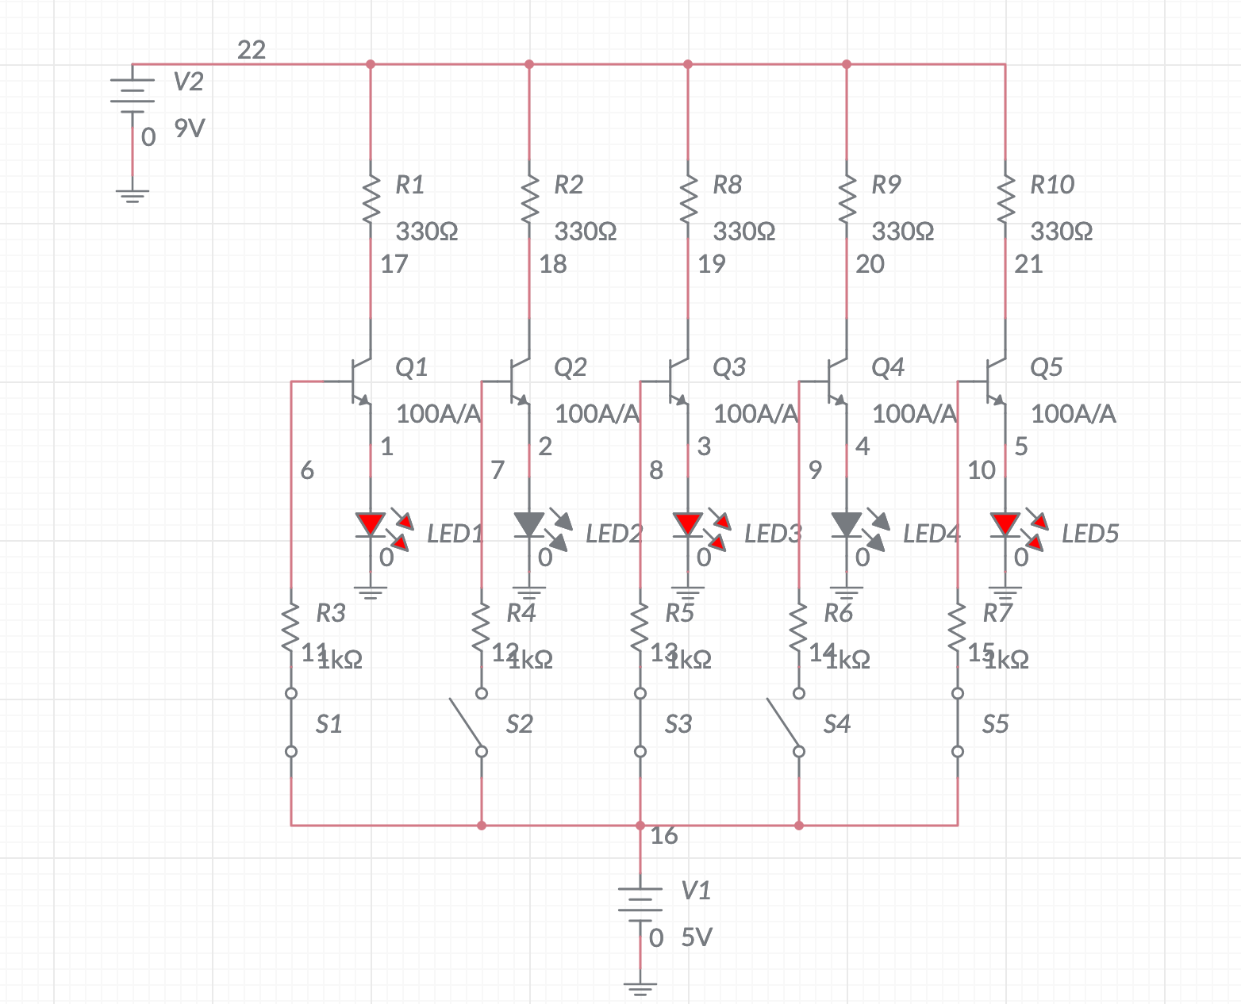
LED Cube Driver
Transistor Switch Array
Uses NPN transistors connected to the Beaglebone to selectively activate each layer of the LED Cube.

Slide 27
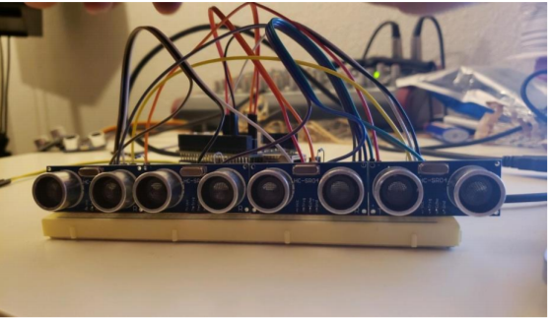
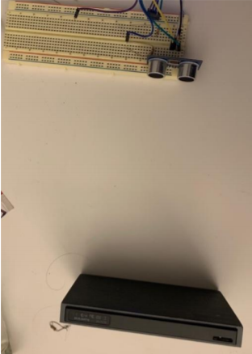
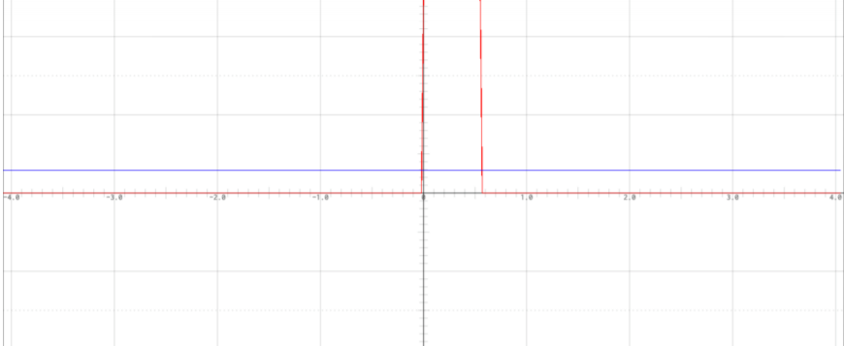
Prototyping
Prototyping began last semester.
We prototyped the Beaglebone with the ultrasonic sensors.

Slide 28
Safety Precautions
Do not operate the device near any liquids to ensure the device is not damaged and no electrocution occurs.
Equip insulator gloves if work on the project must be done on the spot. This will prevent electrical shock.
Ensure that no wires are exposed, loose, or exposed to the elements. This will help prevent degradation and electrical shock. 4.
If the situation arises where the device must be tampered with, please shut off the power and let it sit for a few minutes to ensure the device is not holding any electrical charge.
If any of the LEDs must be replaced, ensure that proper solder safety is followed.

Slide 29
2D Graphics Layer
Data incoming to the BeagleBone is processed by a C++ file and sent to a websocket running JS.
Written in Process for ease of use and speedy graphics development.
GUI is a two way pipeline, Objects can control the Beaglebone (and therefore the cube) just as the Beaglebone can control the Objects.

Slide 30
Stretch Goal: Audio Output
We were able to not only generate visual outputs but also develop an audio unit for our system.
A sine waves pitch and volume can be easily modulated using the positional data cap.
This system is quickly adaptable to other outputs via simple coding.

Slide 31
Stretch Goal: Audio Output

Slide 32
Design Standards
ISO 12224:
Design standard regarding soldering/soldering safety.
ISO/IEC 14882:
Design standard regarding C++
ISO 5577:2017
Design standard regarding Ultrasonic Testing
IEC/EN 62471
Design Standard regarding LED safety.

Slide 33
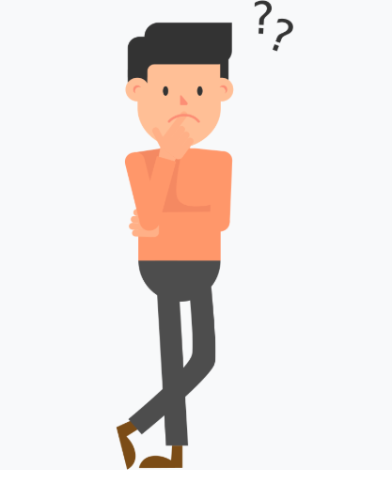
Primary Design Decisions
What power supply to use
What LED will give the best output
How will we get the hardware to connect to the software
What programming language will we use to program in

Slide 34
Design Constraints
Economic Constraints
Environmental Constraints
Money to buy parts
No sponsorships/funding requires us to fund our project ourselves
Making sure all the components aren’t dangerous to the environment.
Making sure all the components can be disposed of if need be in an environmentally friendly way
Social Constraints
Political Constraints
Making sure that our project is not offensive to anyone
Political Constraints usually correspond to taxes and subsidies. Including different policies that may be in effect
Ethical Constraints
Ethical constraints include privacy issues.
Making sure our project does not invade anyone’s privacy
Health Constraints
Making sure the LEDs or other components our project uses does not affect anyone’s health
Manufacturability Constraints
Sustainability Constraints
Making sure our project is able to be manufactured
Limited based on the technology and tools we have at hand.
How durable our project is.
Using materials able to withstand different environments/conditions.

Slide 35
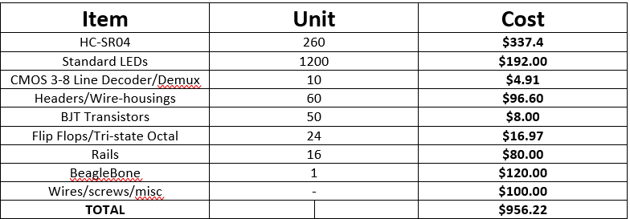
Budget
Our budget is a max of $1000.
Goal is to get parts that are cheap and efficient to reduce costs.
Chart below shows pricing of things we have bought.

Slide 36
Finances to Date- End of Project

Slide 37
Difficulties
Some issues we’ve faced during our project include:
A lot of soldering points
Ensuring each LED in the cube works properly
Wiring for the ultrasonic sensors
Getting schedules to cooperate
Learning new skills in a timely manner

Slide 38
Successes
Good communication among the group through Instant Message
Instead of partitioning work, working on each task collectively
Finding the most time efficient way to design LED cube
Developing a software that communicates between the hardware and software easily.

Slide 39
THANK YOU FOR WATCHING!
Questions??

